Slide 1

VNF Chain Allocation and Management at Data Center Scale
…
Cloud Provider
Tenants
Nodir Kodirov, Sam Bayless, Fabian Ruffy, Ivan Beschastnikh, Holger Hoos, Alan Hu

Slide 2
Network Functions (NF) are useful and widespread
Security
Firewall, DDoS protection, DPI
Monitoring
QoE monitor, Network Stats
Services
Ad insertion, Transcoder
Network optimization
NAT, Load-balancer, WAN accelerator
Sherry et al. find # of middleboxes are ≈ to # of L2/L3 devices in enterprise
Sherry et al. Making Middleboxes Someone Else's Problem: Network Processing as a Cloud Service, SIGCOMM'12
Notes:
Approximation symbol

Slide 3
Benefits of Virtualized Network Functions (VNF)
Elasticity
Quick scale up and down NFs
Fast upgrades
No need to wait for new hardware
Quick configuration, recovery
Failover to the backup NF instance
Outsourcing
Sherry et al. Making Middleboxes Someone Else's Problem: Network Processing as a Cloud Service, SIGCOMM’12
Rajagopalan et al., Split/Merge: System Support for Elastic Execution in Virtual Middleboxes, NSDI’13
Martins et al., ClickOS and the Art of Network Function Virtualization, NSDI'14

Slide 4
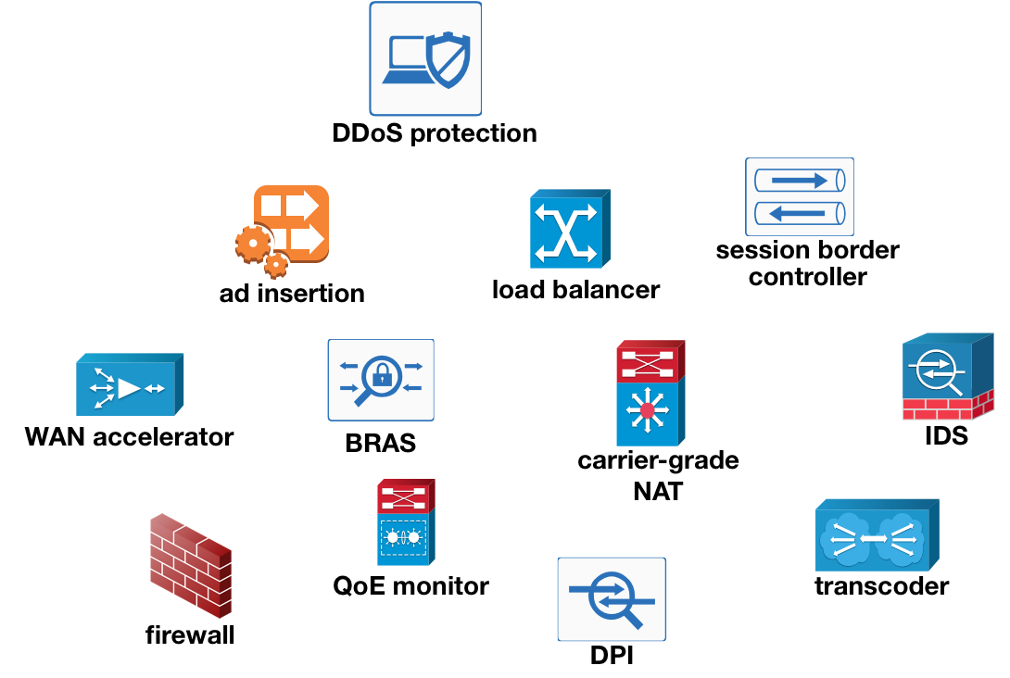
Outsourcing VNFs to the Cloud
Elasticity
Quick scale up and down NFs
Fast upgrades
No need to wait for new hardware
Quick configuration, recovery
Failover to the backup NF instance
Outsourcing
Sherry et al. Making Middleboxes Someone Else's Problem: Network Processing as a Cloud Service, SIGCOMM'12

Slide 5

Outsourcing VNFs to the Cloud
…
chain
Cloud Provider
Tenants

Slide 6
Outsourcing VNF Chains to the Cloud
…
chain
Cloud Provider
Tenants

Slide 7
Challenges of outsourcing VNF Chains
…
chain
Cloud Provider
Tenants

Slide 8
Challenges of outsourcing VNF Chains
How can cloud providers achieve high data center utilization?
How can tenants allocate and manage their VNF chains?
…
…
…
chain
Cloud Provider
Tenants

Slide 9
Challenges of outsourcing VNF Chains
How can cloud providers achieve high data center utilization?
How can tenants allocate and manage their VNF chains?
…
…
…
chain
Cloud Provider
Tenants

Slide 10
Our contributions: API and algorithm
How can cloud providers achieve high data center utilization?
How can tenants allocate and manage their VNF chains?
API to allocate and manage VNF chains
Three algorithms
implement the API, and
achieve high data center utilization
Evaluation
simulate: in data center scale with 1000+ servers
Daisy: emulate chain management at rack-scale
…
Cloud Provider
Tenants

Slide 11
VNF Chain: six API with use-cases
1
2
NAT
2
FW
1
IDS
1
VPN
2
Initial chain
cid ⟵ allocate-chain(C, bw)
remove-link-bandwidth(a, b, bw, cid)
add-link-bandwidth(a, b, bw, cid)
remove-node(f, cid)
add-node(f, cid)
remove-e2e-bandwidth(cid, bw)
1
1
A graph can be transformed arbitrarily by manipulating individual nodes and edges.
2
NAT
2
FW
1
IDS
1
VPN
2
3
NAT
3
FW
2
IDS
2
VPN
3
1
IDS’
1
Chain expand
…
Chain scale-out
Element upgrade
Notes:
Takeaway is “expressiveness” of the API. Because it is expressive these 6 API can handle general chain management.

Slide 12
Scale-out beyond single physical resource capacity
1
2
NAT
2
FW
1
IDS
1
VPN
2
Initial chain
cid ⟵ allocate-chain(C, bw)
remove-link-bandwidth(a, b, bw, cid)
add-link-bandwidth(a, b, bw, cid)
remove-node(f, cid)
add-node(f, cid)
remove-e2e-bandwidth(cid, bw)
10
50
NAT
50
FW
40
IDS
40
VPN
50
Chain scale-out

Slide 13
Chain Abstraction: Abstract-Concrete VNF Chains
10
10
Abstract VNF chain
what tenant requires to allocate and operates on
Concrete VNF chain
cloud provider’s implementation of the abstract chain
Chains abstraction advantages
facilitates high DC utilization
50
40
50
50
40
50
40
50
NAT
FW
40
IDS
VPN
50
NAT
FW
IDS
VPN
Abstract chain (for Tenants)
1
1
NAT
FW
IDS
VPN
5
NAT
FW
IDS
VPN
5
5
4
4
5
5
4
4
5
…
10×
Concrete chains (for Cloud provider)

Slide 14
Our contributions: API and algorithm
How can cloud providers achieve high data center utilization?
How can tenants allocate and manage their VNF chains?
API to allocate and manage VNF chains
Three algorithms
implement the API, and
achieve high data center utilization
Evaluation
simulate: in data center scale with 1000+ servers
Daisy: emulate chain management at rack-scale
…
Cloud Provider
Tenants

Slide 15
Our contributions: API and algorithm
How can cloud providers achieve high data center utilization?
How can tenants allocate and manage their VNF chains?
API to allocate and manage VNF chains
Three algorithms
implement the API, and
achieve high data center utilization
Evaluation
simulate: in data center scale with 1000+ servers
Daisy: emulate chain management at rack-scale
…
Cloud Provider
Tenants

Slide 16
Algorithm inputs: DC topology and chain
1
2
NAT
2
FW
1
IDS
1
VPN
2
1/8 core 1/2 GB
3/8 core 1/2 GB
1/2 core 2 GB
1/4 core 1/2 GB
Expected resource consumption per Gbps of traffic
(see the paper for VNF profile generation)
Palkar et al., E2: A Framework for NFV Applications, SOSP’15
Naik et al., NFVPerf: Online performance monitoring and bottleneck detection for NFV, IEEE NFV-SDN 2016.
Nam et al., Probius: Automated Approach for VNF and Service Chain Analysis in Software-Defined NFV, SOSR'18

Slide 17
Algorithms for Chain Allocation and Management
1
2
NAT
2
FW
1
IDS
1
VPN
2
1/8 core 1/2 GB
3/8 core 1/2 GB
1/2 core 2 GB
1/4 core 1/2 GB
Expected resource consumption per Gbps of traffic
(see the paper for VNF profile generation)

Slide 18
Algorithms for Chain Allocation and Management
Random (baseline)
Consider NFs and servers/switches in random order
Attempt the above step n times (e.g., n=100)
Choose the shortest path between chain NFs
1
2
NAT
2
FW
1
IDS
1
VPN
2

Slide 19
Algorithms for Chain Allocation and Management
Random (baseline)
Consider NFs and servers/switches in random order
Attempt the above step n times (e.g., n=100)
Choose the shortest path between chain NFs
NetPack: Random + 3 simple heuristics
Consider the chain NFs in a topological order
Re-use the same server when allocating consecutive NFs
Gradually increase the network scope: rack, cluster, etc.
VNFSolver: how optimal is NetPack?
Constraint-solver based chain allocation algorithm
Slow, but complete: finds a solution when one exists
E2
Commercial
Facebook
?
?
?
?
?
?
N
# of allocated chains
NetPack
NetPack
NetPack
NetPack
NetPack
Random
Random
R
R
R
R
4-node
10-node
Palkar et al., E2: A Framework for NFV Applications, SOSP’15
Bayless et al., SAT Modulo Monotonic Theories, AAAI'15

Slide 20
Our contributions: API and algorithm
How can cloud providers achieve high data center utilization?
How can tenants allocate and manage their VNF chains?
API to allocate and manage VNF chains
Three algorithms
implement the API, and
achieve high data center utilization
Evaluation
simulate: in data center scale with 1000+ servers
Daisy: emulate chain management at rack-scale
…
Cloud Provider
Tenants

Slide 21
Our contributions: API and algorithm
How can cloud providers achieve high data center utilization?
How can tenants allocate and manage their VNF chains?
API to allocate and manage VNF chains
Three algorithms
implement the API, and
achieve high data center utilization
Evaluation
simulate: in data center scale with 1000+ servers
Daisy: emulate chain management at rack-scale
…
Cloud Provider
Tenants

Slide 22
Evaluation: Objectives
How good is the data center utilization?
Evaluate Random, NetPack, and VNFSolver
Consider three different data center topologies
Use five different VNF chains with varying length (2-10)
How fast is chain allocation?
Measure time it takes to saturate the data center
Does API reliably implement the use-cases?
Prototype scale-out and chain upgrade in Daisy
Use two different racks, two sources of packet traces

Slide 23
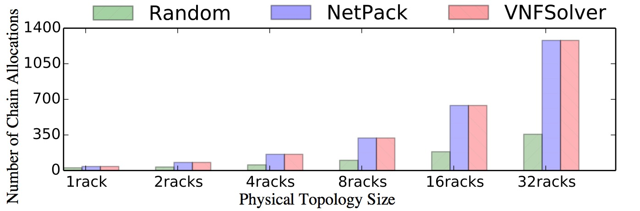
Data center utilization evaluation
NetPack achieves at least 96% of VNFSolver allocations.
Chain allocation time: Random ≲ NetPack ≪ VNFSolver.
1
2
NAT
2
FW
1
IDS
1
VPN
2
Palkar et al., E2: A Framework for NFV Applications, SOSP'15
Notes:
Emphasize: this is a simulation
The commercial and Facebook topologies give qualitatively similar results

Slide 24
NetPack Utilization and Speed
Qualitatively similar results with Facebook and Commercial DC topologies with chains of up to 10 nodes.
(see the paper for details)
NetPack achieves at least 96% of VNFSolver allocations while being 82x faster than VNFSolver (optimal) and only up to 54% slower (per chain) than Random (baseline) on average.
Notes:
Emphasize: this is a simulation
The commercial and Facebook topologies give qualitatively similar results

Slide 25
Feasibility check: can API be implemented?
Daisy builds on Sonata framework
Mininet to build DC topology
OVS for switches, and Dockers for NFs
Runs on a single Azure VM
64 cores, 432 GB RAM
Emulates use-cases and chain arrivals
scale-out and upgrade use-cases
continuous arrival of tenant chains in rack-scale
DAISY
mininet
Peuster et al., Sonata NFV SDK, github.com/sonata-nfv/son-emu, 2017
Notes:
Better title for this slide?

Slide 26
VNF Chain use-cases are feasible with narrow API
1
1
2
NAT
2
FW
1
IDS
1
VPN
2
3
NAT
3
FW
2
IDS
2
VPN
3
Initial chain
Chain scale-out
Daisy implements scale-out with no packet drops.___

Slide 27
VNF Chain use-cases are feasible with narrow API
Daisy Contributions
1
1
2
NAT
2
FW
1
IDS
1
VPN
2
3
NAT
3
FW
2
IDS
2
VPN
3
Initial chain
Chain scale-out
Daisy implements scale-out with no packet drops and element upgrade with 1s packet drop at most.
We also emulated continuous chain arrival case where different tenants make chain allocation requests one-by-one.
Daisy implements scale-out with no packet drops.___

Slide 28
Contributions
…
Cloud Provider
Tenants
API with six primitives
Implements wide-range of chain operations
Chain abstraction facilitates full DC utilization
NetPack algorithm
Handles DC-scale allocation with 1000+ servers
Achieves at least 96% allocations of VNFSolver (optimal) while being 82x faster on average
Daisy prototype
Demonstrates feasibility of API and algorithms
How can tenants allocate and manage their VNF chains?
How can cloud providers achieve high data center utilization?
Thank you!

Slide 30
Backup Slides

Slide 31
Chain Abstraction: Abstract-Concrete VNF Chains
10
Abstract VNF chain
what tenant requires to allocate and operates on
Concrete VNF chain
cloud provider’s implementation of the abstract chain
Chains abstraction advantages
facilitates high DC utilization
Challenges
low-latency, packet loss, state synchronization, efficiency loss (see the paper and ANCS’18 poster)
50
NAT
50
FW
40
IDS
40
VPN
50
Abstract chain (for Tenants)
1
5
NAT
5
FW
4
IDS
4
VPN
5
…
10×
1
5
NAT
5
FW
4
IDS
4
VPN
5
Concrete chains (for Cloud provider)

Slide 32
Topological sort of VNF chain
An example using Kahn’s algorithm
(VPN, NAT, LB, FW3, FW1, FW2, WC, DPI, IPS, GW)
A. B. Kahn, Topological sorting of large networks, Communications of the ACM, 1962
Notes:
Emphasize: this is a simulation
The commercial and Facebook topologies give qualitatively similar results

Slide 33
VNF Chains
Chains (a) and (b) are from OpenBox, (c) and (e) are from E2, and (d) is from Embark.
Bremler-Barr et al., OpenBox: A Software-Defined Framework for Developing, Deploying, and Managing Network Functions, SIGCOMM’16 Palkar et al., E2: A Framework for NFV Applications, SOSP'15
Chang et al., Embark: Securely Outsourcing Middleboxes to the Cloud, NSDI'16
Notes:
Emphasize: this is a simulation
The commercial and Facebook topologies give qualitatively similar results

Slide 34
NetPack: Contribution of each Optimization

Slide 35
VNF Chain use-cases are feasible with narrow API
add-node()
1
add-link-bandwidth()
2
NAT
FW
IDS
VPN
remove-link-bandwidth()
2
1
1
2
remove-node()
1
1
3
NAT
3
FW
2
IDS
2
VPN
3
2
NAT
2
FW
1
IDS2
1
VPN
2
Chain scale-out
Element upgrade
Daisy implements scale-out with no packet drops and element upgrade with 1s packet drop at most (not shown).

Slide 36
Daisy Contributions
1
2
NAT
2
FW
1
IDS
1
VPN
2
VNFSolver allocated 75 concrete chains (687 Mbps)
NetPack allocated 67 concrete chains (633 Mbps)
Random allocated 61 concrete chains (561 Mbps)
(throughput with iperf generated packets is precise)

Slide 37
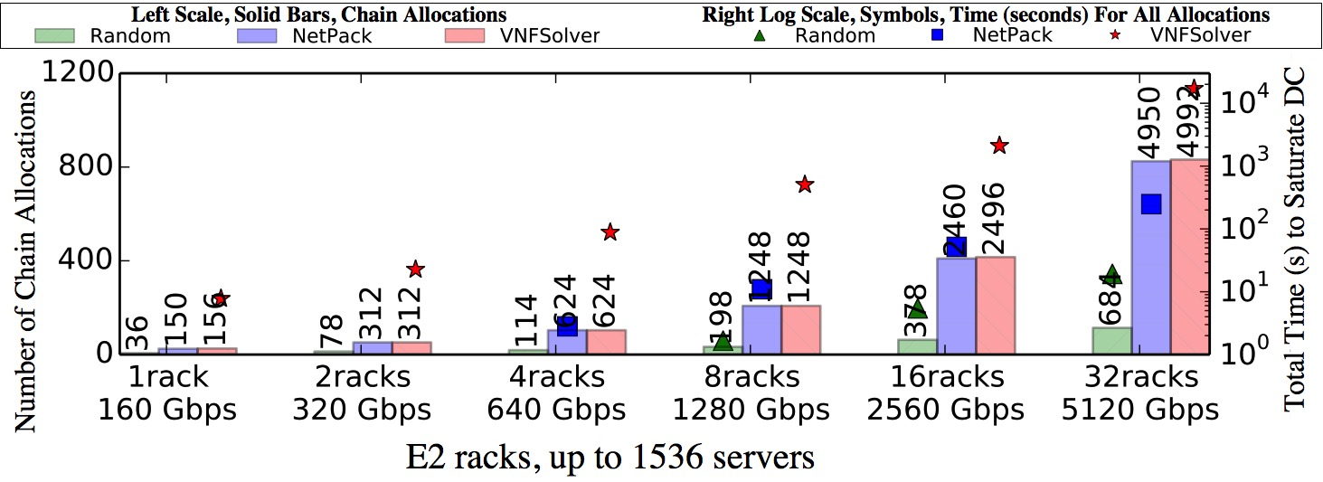
Utilization and Speed on E2 racks
NetPack achieves at least 96% of VNFSolver allocations while being 82x faster than VNFSolver on average.
Palkar et al., E2: A Framework for NFV Applications, SOSP'15
Notes:
Emphasize: this is a simulation
The commercial and Facebook topologies give qualitatively similar results

Slide 38
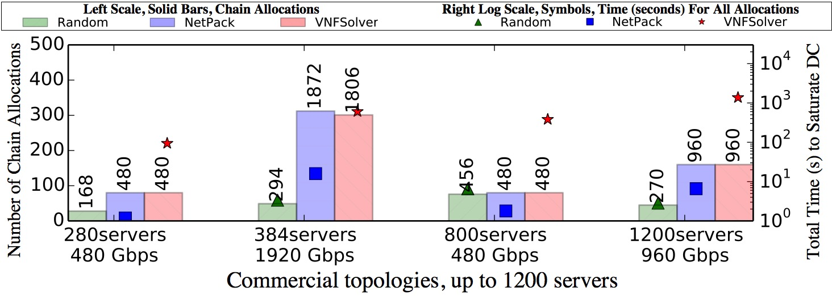
Utilization and Speed on Commercial Topologies
Gives qualitatively similar results, but also reveals a corner case for VNFSolver (-3.65%).

Slide 39
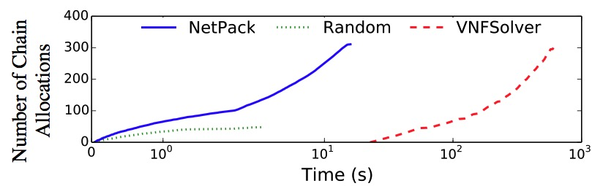
A corner case for VNFSolver
Variance across 10 runs:
Random < 10.4%
NetPack < 0.7%
VNFSolver < 3.7%
Gives qualitatively similar results, but also reveals a corner case for VNFSolver (-3.65%).

Slide 40
Daisy: emulate continuous chain arrival
1
2
NAT
2
FW
1
IDS
1
VPN
2
VNFSolver allocated 75 chains (687 Mbps)
NetPack allocated 67 chains (633 Mbps)
Random allocated 61 chains (561 Mbps) (throughput with iperf generated packets is precise)

Slide 41
Daisy Contributions
Daisy reliably implements wide-range of use-cases
and handles chain arrival from different tenants.

